Slide 1


CS8811 Project Work Final Review
R.M.K. Engineering College
(An Autonomous Institution)
R.S.M. Nagar, Kavaraipettai-601 206, Gummidipoondi Taluk, Thiruvallur District.
Affiliated to Anna University, Chennai / Approved by AICTE, New Delhi. Accredited by NAAC with A+ Grade / ISO 9001 : 2015 Certified Institution.
All the UG Programs are Accredited by NBA, New Delhi.
Project Title : ENHANCED EXTRACTION OF TEXTUAL CHARACTERS FROM MULTIMEDIA USING NLP
Team Members
K DINESH – 111719104044
T BHARATH – 111719104022
B SUMANTH – 111719104030
Project Guide
Dr. P. KAVITHA
Associate Professor

Slide 2
1. Abstract
Enhanced extraction of textual characters represents a comprehensive framework for detection and recognition of textual content in video frames as well as in images. Detection of text from document images enables Natural Language Processing algorithms to decipher the text and make sense of what the document conveys. Furthermore, the text can be easily translated into multiple languages, and summarizes the text in to meaningful phrases using the transformers and pipelines in NLP text summarization. Then converts the summarizer text to an audio using Text-To-Speech library. The development of this application which will be great help to people with visual impairment and those who don’t know other language.

Slide 3
1.2 Objective
1.1 Problem Statement
The domain has starting with trivial systems recognizing isolated digits and characters to complex end-to-end systems capable of reading text in natural scenes.
This project presents an overview of the notable contributions to detection and recognition of textual content in images and videos.
The objective of OCR is to achieve modification or conversion of any form of text or text-containing documents such as handwritten text, printed or scanned text images, into an editable digital format for deeper and further processing.
The main idea of ​​this project is to select text characters from the video frames and summarizes the whole paragraph from an image for easy understanding.

Slide 4
2. Review of Literature
S .No. | Title of the Paper | Journal Name | Authors | Year | Methodology | Limitations
1 | Multilingual artificial text extraction and script identification from video images | IEEE on advanced Computer Science Application | Jamil, A. Batool, Z. Malik, A. Mirza, I. Siddiqi | 2016 | Improved CTPN English Text Detection Algorithm Improved CRNN English Text Recognition Algorithm Algorithm Simulation Test and Result Analysis | it is found that there is a high time complexity and space complexity, which will occupy a large amount of computing resources during detection.
2 | Automatic script identification from images using cluster-based templates | IEEE in document analysis and recognition | J. Hochberg, L. Kerns, P. Kelly, T. Thomas | 1995 | a wide range of systems can be developed at the application layer including indexing and retrieval, key-word-based alert generation, and content summarization. | The system will be optimized to work on live streams in addition to archived videos. This will in turn allow development of keyword based alert generation systems.
3 | Determination of the script and language content of document images | IEEE application on image classification | A. L. Spitz | 1997 | In this text detection technique consists of four major steps: pre-processing, text localization, text line formation and text identification. | In this work, they can’t be extended considering videos containing text of different orientations and languages.
4 | Automatic identification of English, Chinese, Arabic, Devnagari and Bangla script line | IEEE on classification of text, Washington | U. Pal, B. Chaudhuri | 2001 | They explore the moments to estimate deviation between temporal frames to separate caption from scene text and background pixels. | The performance of the proposed approach may degrade for arbitrary text movements because it expects constant velocity for text detection in this work

Slide 5
S .No. | Title of the Paper | Journal Name | Authors | Year | Methodology | Limitations
5 | Text detection in images using texture feature from strokes | Springer in advances in multimedia information processing | C. Zhu, W. Wang, Q. Ning | 2006 | The proposed method comprises two phases: the coarse candidate regions detection and the fine CNN text line localization. | The result show that our method is capable of handling a wide range of videos robustly.
6 | Effective and efficient video text extraction using key text points. IET Image Process | IET Image Processing | Z. Li, G. Liu, X. Qian, D. Guo, H. Jiang | 2011 | It is also observed that the Sobel operator gives few pixels for the background while the Canny operator gives a lot of edges with different patterns for the same background. | This is followed by false positive elimination based on some heuristics. The experimental results on ICDAR and MSRA-TD500 data show that the proposed method outperforms the existing methods in terms of precision and F-measure.
7 | Word-wise script identification from video frames | IEEE on screen text detection, Washington | N. Sharma, S. Chanda, U. Pal, M. Blumenstein | 2013 | In this paper we mainly discuss text detection, localization, tracking methods for video text. Using text tracking result background subtraction and text enhancement can be performed in a very simple way. | The proposed scheme does not work well when texts are in complex non-linear motion, such as zooming in/out, rotation and free movement of scene text
8 | Script and language identification from document images | IEEE on document analysis, San Juan | G. Peake, T. Tan | 1997 | In this paper, we proposed a new video scene text detection method that made use of a new enhancement method using Laplacian and Sobel operations of input images to enhance low contrast text pixels. | Notwithstanding the current limitations that we will deal with in our future research, the contribution of this paper lies in our continued effort in detecting multioriented text lines in videos, which hitherto has not been well explored by others.

Slide 6
S .No. | Title of the Paper | Journal Name | Authors | Year | Methodology | Limitations
9 | Gradient-angular features for word-wise video script identification | IEEE on pattern recognition | P. Shivakumara, N. Sharma, U. Pal, M. Blumenstein, C. L. Tan | 2014 | The proposed method comprises two phases: the coarse candidate regions detection and the fine CNN text line localization. | The result show that our method is capable of handling a wide range of videos robustly.
10 | A study on word-level multi-script identification from video frames | IEEE in neural networks | N. Sharma, U. Pal, M. Blumenstein | 2014 | It is also observed that the Sobel operator gives few pixels for the background while the Canny operator gives a lot of edges with different patterns for the same background. | This is followed by false positive elimination based on some heuristics. The experimental results on ICDAR and MSRA-TD500 data show that the proposed method outperforms the existing methods in terms of precision and F-measure.
11 | competition on video script identification | IEEE on video script detection | N. Sharma, R. Mandal, R. Sharma, U. Pal, M. Blumenstein | 2015 | In this paper we mainly discuss text detection, localization, tracking methods for video text. Using text tracking result background subtraction and text enhancement can be performed in a very simple way. | The proposed scheme does not work well when texts are in complex non-linear motion, such as zooming in/out, rotation and free movement of scene text
12 | Scene text script identification with convolutional recurrent neural networks | IEEE on pattern recognition | J. Mei, L. Dai, B. Shi, X. Bai | 2016 | In this paper, we proposed a new video scene text detection method that made use of a new enhancement method using Laplacian and Sobel operations of input images to enhance low contrast text pixels. | Notwithstanding the current limitations that we will deal with in our future research, the contribution of this paper lies in our continued effort in detecting multioriented text lines in videos, which hitherto has not been well explored by others.

Slide 7
S .No. | Title of the Paper | Journal Name | Authors | Year | Methodology | Limitations
13 | A simple and effective solution for script identification in the wild | IEEE on document analysis systems | A. K. Singh, A. Mishra, P. Dabral, C. Jawahar | 2016 | The proposed method comprises two phases: the coarse candidate regions detection and the fine CNN text line localization. | The result show that our method is capable of handling a wide range of videos robustly.
14 | A fine-grained approach to scene text script identification | IEEE on document analysis systems | L. Gomez, D. Karatzas | 2016 | It is also observed that the Sobel operator gives few pixels for the background while the Canny operator gives a lot of edges with different patterns for the same background. | This is followed by false positive elimination based on some heuristics. The experimental results on ICDAR and MSRA-TD500 data show that the proposed method outperforms the existing methods in terms of precision and F-measure.
15 | CNN based transfer learning for scene script identification | Springer on neural image processing | M. Tounsi, I. Moalla, F. Lebourgeois, A. M. Alimi | 2017 | In this paper we mainly discuss text detection, localization, tracking methods for video text. Using text tracking result background subtraction and text enhancement can be performed in a very simple way. | The proposed scheme does not work well when texts are in complex non-linear motion, such as zooming in/out, rotation and free movement of scene text
16 | Improving patch-based scene text script identification with ensembles of conjoined networks | IEEE on image classification | L. Gomez, A. Nicolaou, D. Karatzas | 2017 | In this paper, we proposed a new video scene text detection method that made use of a new enhancement method using Laplacian and Sobel operations of input images to enhance low contrast text pixels. | Notwithstanding the current limitations that we will deal with in our future research, the contribution of this paper lies in our continued effort in detecting multioriented text lines in videos, which hitherto has not been well explored by others.

Slide 8
3. Hardware and Software Used
3.1 Hardware Used
Processor : Any Processor above 500 MHz.
Ram : 4 GB
Hard Disk : 4 GB
Input device : 4 GB
Output device : VGA and High Resolution
3.2 Software Used
Operating System :Windows 7 or higher
Programming : Python 3.6 and related libraries
Machine Learning : Matplotlib, Scikit Learn, OpenCV
Modules / Libraries : Easyocr, spacy, googletrans, pyttsx3
Tool : Anaconda with Jupyter Notebook

Slide 9
4. Existing System
A Text-to-speech synthesizer is an application that converts text into spoken word, by analysing and processing the text using Natural Language Processing (NLP) and then using Digital Signal Processing (DSP) technology to convert this processed text into synthesized speech representation of the text.
Here, they developed a useful text-to-speech synthesizer in the form of a simple application that converts inputted text into synthesized speech and reads out to the user in an saved as mp3.file.
The development of a text to speech synthesizer will be help to people with visual impairment and make making through large volume of text easier.
Disadvantages
They are not summarising the whole paragraph from an image for easy understanding.
Advanced NLP concepts not used.

Slide 10
5. Proposed System
Our proposed model is to built an application for video/Image-To-Text-Speech. . It also detect the text when webcam placed in any textual regions.
It is an important for the people with visual impairment. Our application is built to read any form of text images in any languages which is then converted to a English text using a translator package in python.
The converted text is summarised into phrases for better understanding the whole meaning in the paragraph using transformers and pipeline Natural language processing.
The summarized text is converted into an audio using Text-To-Speech library of NLP.
It also extracts the text from the running Webcam and the summarizes the text in to meaningful phrases and convert it to an audio format for the use of people with visual impairment.

Slide 11
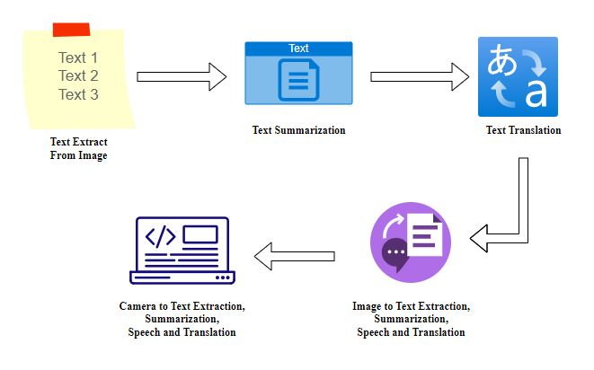
6. Architecture Diagram

Slide 12
7. Methodology
We start by Accessing images on the webcam or system images. Second, we process the data by detecting texts that are presented in the given image. we develop a variety of algorithms for each module and compute performance measures like accuracy, recall, precision, F1 score, etc. Next we summarize the textual characters using some negation techniques . Then, in order to compare and select the language for translation. Using python audio module, we tend the system to speech the text that feed it into the system. The following are the modules used in this system.
Each module starting with accessing image, text detection, text summarization are detected by using different supervised ML algorithms and the translation and speech representation are predicted by using default library involved in python.

Slide 13
7.1 Accessing the Webcam
We are using the module named OpenCV to read the image from the given input and the color space of the image is first changed and stored in a variable. For color conversion we use the function cv2.cvtColor(input_image, flag). The second parameter flag determines the type of conversion. We can chose among cv2.COLOR_BGR2GRAY and cv2.COLOR_BGR2HSV. Here, we use cv2.COLOR_BGR2GRAY that helps us to convert an RGB image to gray scale image. A threshold is applied to the converted image using cv2.threshold function. The basic Thresholding technique is Binary Thresholding. For every pixel, the same threshold value is applied. If the pixel value is smaller than the threshold , it is set to 0, otherwise, it is set to a maximum value.

Slide 14
7.2 Text Detection and Recognition
Using Python And The PyTorch Library, EasyOCR Is Implemented. The Underlying PyTorch Deep Learning Library Can Accelerate Your Text Detection EasyOCR Is Able To Write OCR Texts In 70+ Languages Including English, Hindi, Russian, Chinese, And More. EasyOCR Is Good For Clean Document Scanning And Would Result In Greater Accuracy And Support For LSTM. The detection part is using the CRAFT algorithm and the Recognition model is CRNN. Steps Involved in Detection and Recognition part of Video frames :
Import the Easy OCR and thus the necessary libraries to open an image and use it for recognition.
Select the language in which you want to extract the text.
Read and open the image you want to extract the text from.
Calculate the accuracy of box bounds for the text in the image.
Draw the box bounds for the text in the image.

Slide 15
7.2.1 To Extract the text from the scene image :
Many deep learning models in computer vision have been used for the scene text detection task over the past few years. However, the performance of these models is not up to the mark when the text in the image is skewed or curved. The CRAFT model performs well on even curved, long and deformed texts in addition to normal text. The CRAFT text detection model uses a convolutional neural network model to calculate region scores and affinity scores. The region score is used to localize character regions while the affinity score is used to group the characters into text regions. CRAFT uses a fully convolutional neural network based on the VGG16 model. The inference is done by providing word-level bounding boxes. The CRAFT text detection model works well at various scales, from large to small texts and is shown to be effective on unseen datasets as well. The time taken by CTPN, EAST and MSER text detection methods is lower compared to the CRAFT text detection engine. However, CRAFT is more accurate and the bounding boxes are more precise when the text is long, curved, rotated or deformed.

Slide 16
7.2.2 To Recognize the text from the bounded region of image :
After the text detection step, regions, where the text is present, are cropped and sent through convolutional layers to get the features from the image. Later these features are fed to many-to-many LSTM architecture, which outputs soft max probabilities over the vocabulary. These outputs from different time steps are fed to the CTC decoder to finally get the raw text from images. One can relate this to training any LSTM model with word embeddings like word2vec, Glove, fast Text. In the modelling, we are making a sequential model. The first layer of the model is the embedding layer which uses the 32 length vector, and the next layer is the LSTM layer which has 100 neurons which will work as the memory unit of the model. After LSTM, the dense layer which is an output layer with sigmoid function, sigmoid function helps in providing the labels.

Slide 17
7.3 Text Summarization
We have used Spacy to import a pre-trained NLP pipeline to help interpret the grammatical structure of the text. This will allow us to identify the most common words that are often useful to filter out (i.e. STOP_WORDS) as well as the punctuation (i.e. punctuation). We’ll also use the n largest function to extract a percentage of the most important sentences.
Our algorithm will use the following steps:
Tokenize the text with the Spacy pipeline. This segments the text into words, punctuation, and so on, using grammatical rules specific to the English language.
Count the number of times a word is used (not including stop words or punctuation), then normalize the count. A word that’s used more frequently has a higher normalized count.
Calculate the sum of the normalized count for each sentence.
Extract a percentage of the highest ranked sentences. These serve as our summary.

Slide 18
7.3.1 To Tokenize the recognized text to the specified amount :
The NegEx algorithm relies on four types of lexical cues: negation triggers that indicate a negation (e.g., “denies”), pseudo-negation triggers that contain negation triggers but do not negate the clinical condition (e.g., “no increase”), and termination terms that stop the scope of the negation trigger (e.g., “but”). Any clinical condition within the scope of a negation trigger is negated. All NegEx lexical items have an action—negation and pseudo-negation triggers can modify information to the right of the term (i.e., forward in the sentence) or to the left of the term (i.e., backward in the sentence). Termination terms have an action to terminate scope, which otherwise terminates at the end of the sentence. Pseudo negation triggers attempt to compensate for NegEx’s lack of syntax by listing exceptions to the occurrence of negation triggers such as “no” in phrases like “no previous”. Because the lexicon is the keystone of the algorithm, adaptation of Neg Ex to other languages relies mainly on translation of the lexical cues.

Slide 19
7.4 Text Translation
We imported the required package. we created an instance of Translator class and assigned it to translator variable. we performed the translation of the text. (If the source language is not given, google translate attempts to detect the source language. If the target language is not given, it will translate your text to English by default.) we printed the translated text. we translated the text in Korean to English by specifying the destination, or target language, as en. we printed the translated text. Likewise we can also translate the English text to Tamil and any other languages by specifying destination as the language we want.

Slide 20
7.5 Speech Representation
First of all, we‘re going to import the pyttsx3 package that we’ve installed using the pip.
*Pyttsx3 Engine Initialization engine = pyttsx3.init()
The above code initializes the pyttsx3 package. The Instance of the initialized pyttsx3 package is stored in the engine variable. We are calling the variable engine as it works as the engine and converts Text-To-Speech whenever execute the functions from the package.
Say Function in pyttsx3
*engine.say("This is Text-To-Speech Engine Pyttsx3")There is a built-in say() function in the pyttsx3 package that takes a string value and speaks it out.
*runAndWait
*engine.runAndWait()
This function keeps track when the engine starts converting text to speech and waits for that much time, and do not allow the engine to close. After all the processes are over, we shut down the engine by calling the *stop() function.

Slide 21
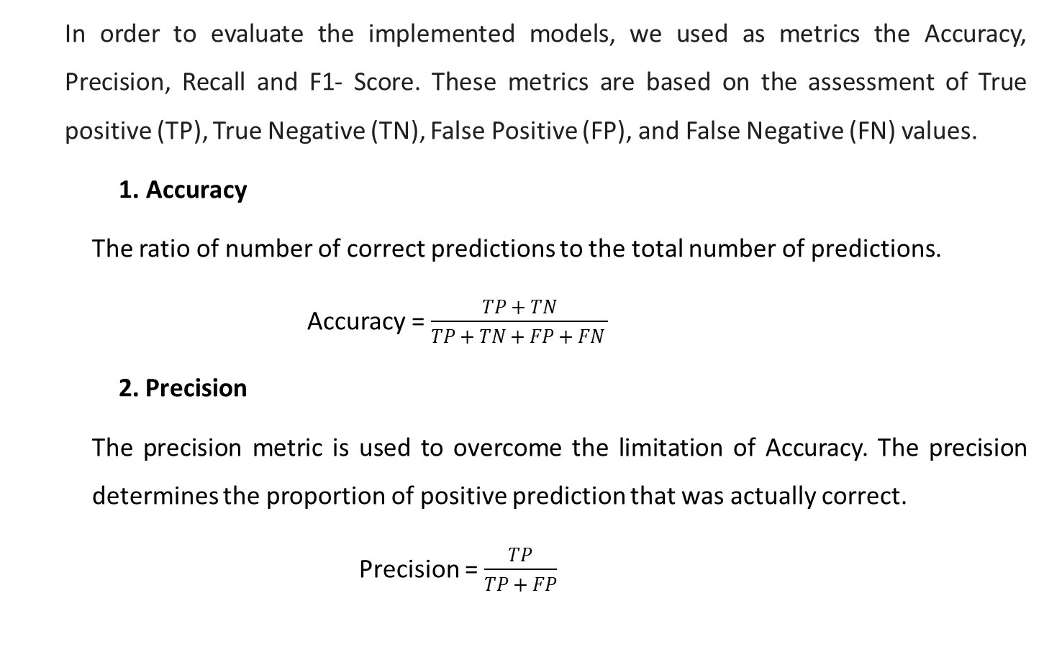
8. Performance Metrices
In order to evaluate the implemented models, we used as metrics the Accuracy, Precision, Recall and F1- Score. These metrics are based on the assessment of True positive (TP), True Negative (TN), False Positive (FP), and False Negative (FN) values.
Accuracy
The ratio of number of correct predictions to the total number of predictions.
Accuracy = $\frac{TP + TN}{TP + TN + FP + FN }$
2. Precision
The precision metric is used to overcome the limitation of Accuracy. The precision determines the proportion of positive prediction that was actually correct.
Precision = $\frac{TP}{TP + FP}$

Slide 22
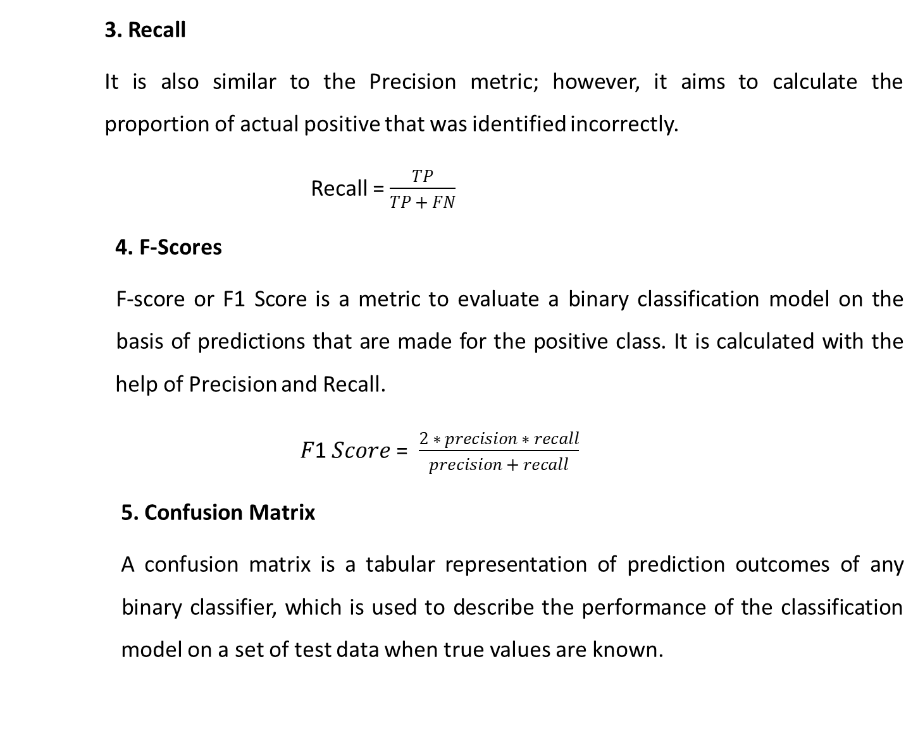
3. Recall
It is also similar to the Precision metric; however, it aims to calculate the proportion of actual positive that was identified incorrectly.
Recall = $\frac{TP}{TP + FN}$
4. F-Scores
F-score or F1 Score is a metric to evaluate a binary classification model on the basis of predictions that are made for the positive class. It is calculated with the help of Precision and Recall.
𝐹1 𝑆𝑐𝑜𝑟𝑒 = $\frac{2 ∗ precision ∗ recall}{precision + recall}$
5. Confusion Matrix
A confusion matrix is a tabular representation of prediction outcomes of any binary classifier, which is used to describe the performance of the classification model on a set of test data when true values are known.

Slide 23
Table 8.1 Performance Metrices
S.NO | ALGORITHM | PRECISION | RECALL | F_SCORE | ACCURACY (%)
1 | CRAFT | 0.90 | 0.92 | 0.91 | 91
2 | LSTM | 0.98 | 0.94 | 0.96 | 95
3 | NegEX | 0.87 | 0.90 | 0.89 | 88
4 | GNMT | 0.92 | 0.93 | 0.96 | 95

Slide 24
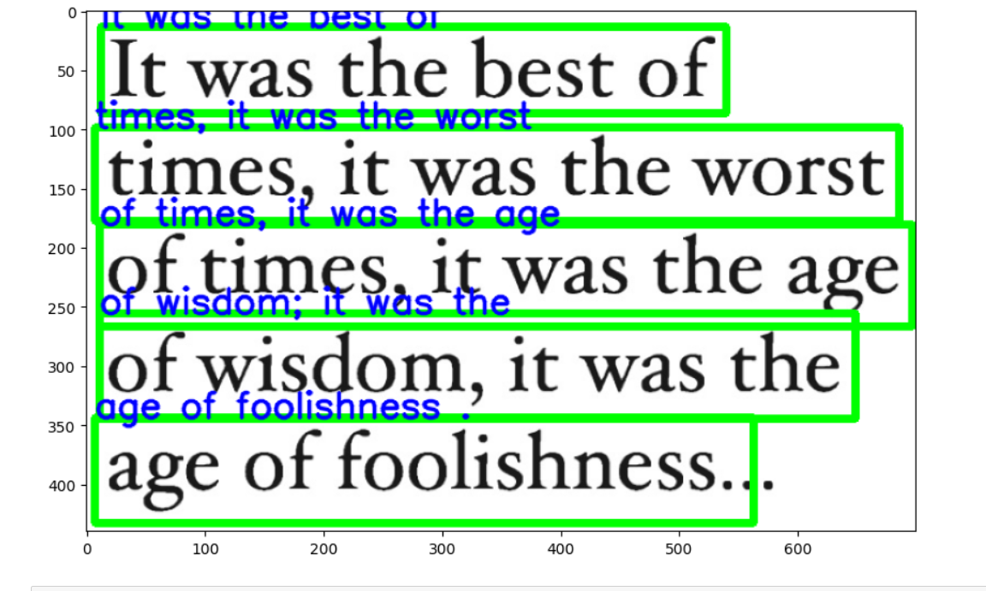
Image to Text Detection
9. Experimental Results

Slide 25
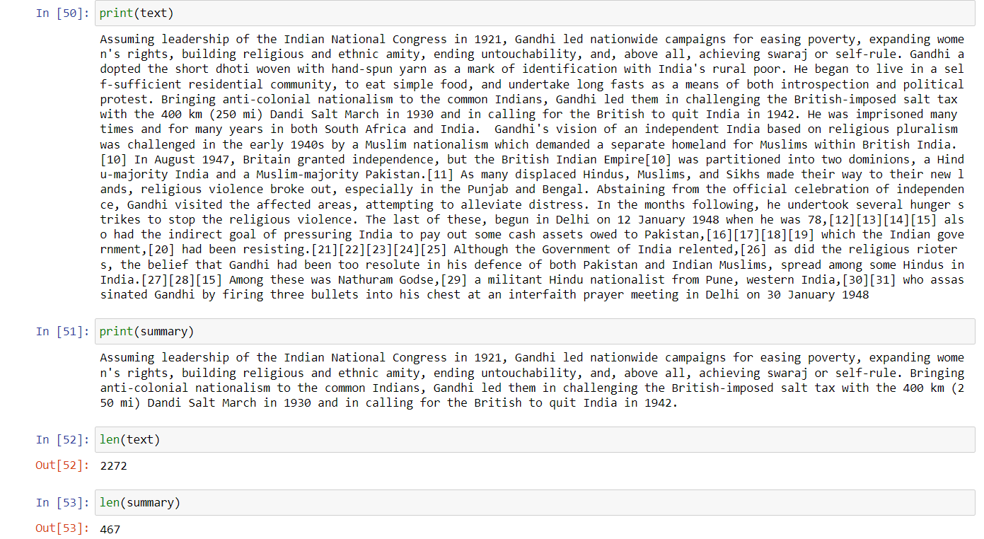
Summarization

Slide 26
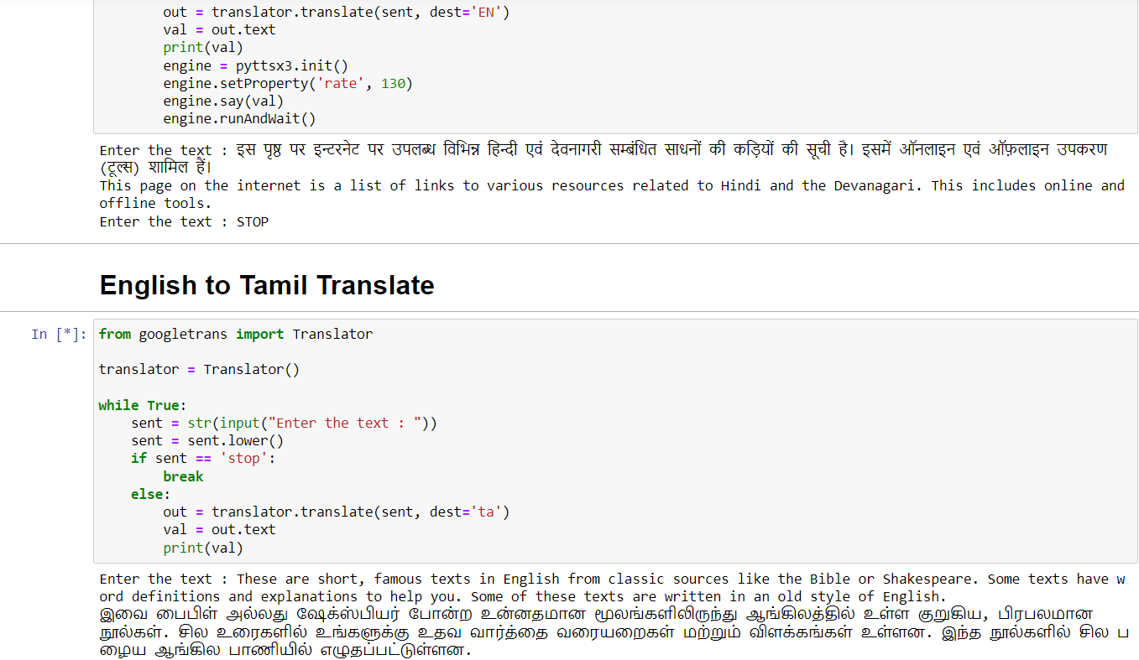
Translation

Slide 27
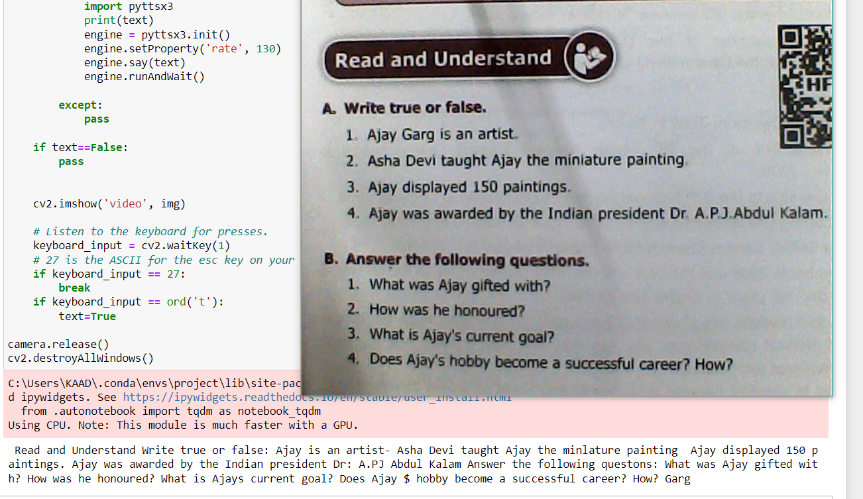
Webcam to Text Detection

Slide 28
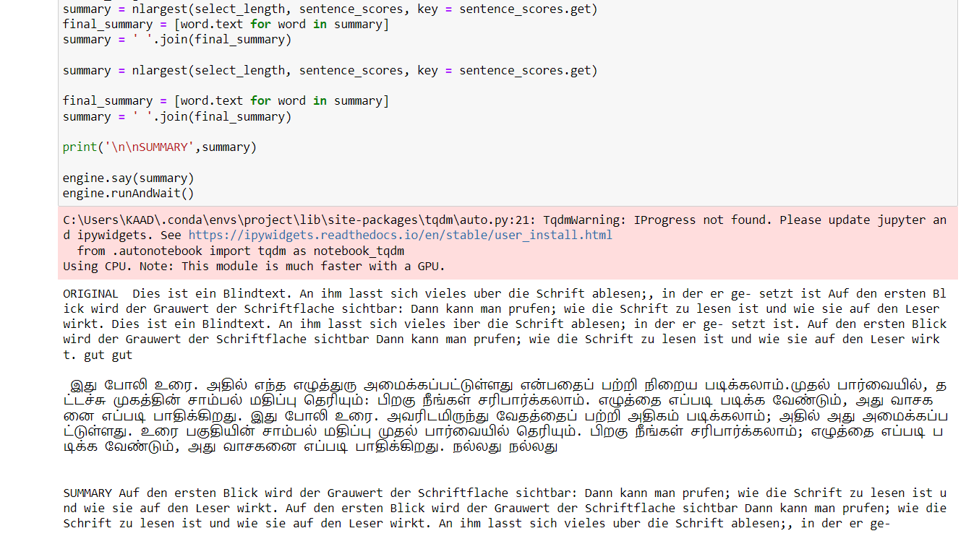
Detected text to Summarization, Translation, and Speech Representation

Slide 29
10. Conclusion
In this project, we presented a comprehensive framework for text detection and recognition in video frames containing textual occurrences in English and other languages. A number of contributions are made in the presented study, We developed a comprehensive dataset of video frames with ground truth information allowing evaluation of detection and recognition tasks. For detection of textual regions, we employed state-of-the-art deep learning-based object detectors and fine-tuned them to detect text in multiple scripts. Script of the detected textual regions is identified using CNNs in a classification framework. A combination of CNN and bidirectional LSTMs which reports high recognition rates for the challenging video text in English. For summarization of detected text, we employed a negation method using NegEx which avoiding unwanted phrase, extra symbols and repeated words. Implementation of summarising the text is helpful in understand the whole context of the text or paragraph. For translation process, we earned a process of google translation which have already been worked in a highest accuracy. For the speech Representation, we just developed a python code to given in an audio format.

Slide 30
11. References
[1] Jamil, A. Batool, Z. Malik, A. Mirza, I. Siddiqi, “Multilingual artificial text extraction and script identification from video images.” Int. J. Adv. Comput. Sci. Appl. 1(7), 529–539 (2016)
[2] J. Hochberg, L. Kerns, P. Kelly, T. Thomas, in Document Analysis and Recognition, 1995., Proceedings of the Third International Conference On, vol. 1. “Automatic script identification from images using cluster-based templates” (IEEE, Montreal, 1995), pp. 378–381
[3] A. L. Spitz, “Determination of the script and language content of document images.” IEEE Trans. Patt. Anal. Mach. Intell. 19(3), 235–245 (1997)
[4] U. Pal, B. Chaudhuri, in Document Analysis and Recognition, 2001. Proceedings. Sixth International Conference On. “Automatic identification of English, Chinese, Arabic, Devnagari and Bangla script line” (IEEE, Washington, 2001), pp. 790–794
[5] C. Zhu, W. Wang, Q. Ning, in Advances in Multimedia Information Processing- PCM 2006. “Text detection in images using texture feature from strokes” (Springer, Hangzhou, 2006), pp. 295–301
[6] Z. Li, G. Liu, X. Qian, D. Guo, H. Jiang, “Effective and efficient video text extraction using key text points. IET Image Process.” 5(8), 671–683 (2011)
[7] N. Sharma, S. Chanda, U. Pal, M. Blumenstein, in Document Analysis and Recognition (ICDAR), 2013 12th International Conference On. “Word-wise script identification from video frames” (IEEE, Washington, 2013), pp. 867–871
[8] G. Peake, T. Tan, in Document Image Analysis, 1997.(DIA’97) Proceedings., Workshop On. “Script and language identification from document images” (IEEE, San Juan, 1997), pp. 10–17

Slide 31
[9] P. Shivakumara, N. Sharma, U. Pal, M. Blumenstein, C. L. Tan, in Pattern Recognition (ICPR), 2014 22nd International Conference On. “Gradient-angular features for word-wise video script identification” (IEEE, Stockholm, 2014), pp. 3098–3103
[10] N. Sharma, U. Pal, M. Blumenstein, in Neural Networks (IJCNN), 2014 International Joint Conference On. “A study on word-level multi-script identification from video frames” (IEEE, Beijing, 2014), pp. 1827–1833
[11] N. Sharma, R. Mandal, R. Sharma, U. Pal, M. Blumenstein, in Document Analysis and Recognition (ICDAR), 2015 13th International Conference On. Icdar2015 “competition on video script identification” (CVSI 2015) (IEEE, Nancy, 2015), pp. 1196–1200
[12] J. Mei, L. Dai, B. Shi, X. Bai, in 2016 23rd International Conference on Pattern Recognition (ICPR). “Scene text script identification with convolutional recurrent neural networks” (IEEE, Cancún, 2016), pp. 4053–4058
[13] A. K. Singh, A. Mishra, P. Dabral, C. Jawahar, in Document Analysis Systems (DAS), 2016 12th IAPR Workshop On. “A simple and effective solution for script identification in the wild” (IEEE, Santorini, 2016), pp. 428–433
[14] L. Gomez, D. Karatzas, in Document Analysis Systems (DAS), 2016 12th IAPR Workshop On. “A fine-grained approach to scene text script identification” (IEEE, Santorini, 2016), pp. 192–197
[15] M. Tounsi, I. Moalla, F. Lebourgeois, A. M. Alimi, in International Conference on Neural Information Processing. “CNN based transfer learning for scene script identification” (Springer, California, 2017), pp. 702–711
[16] L. Gomez, A. Nicolaou, D. Karatzas, “Improving patch-based scene text script identification with ensembles of conjoined networks.” Patt. Recogn. 67, 85–96 (2017)

